Slide 1
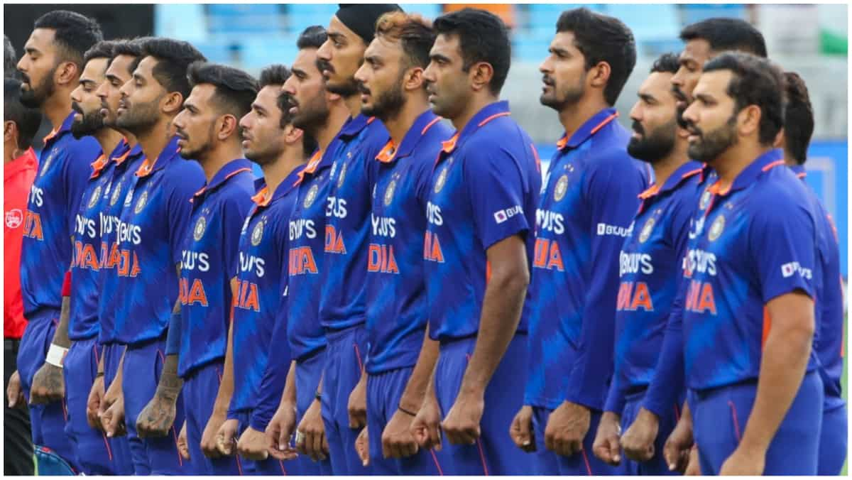
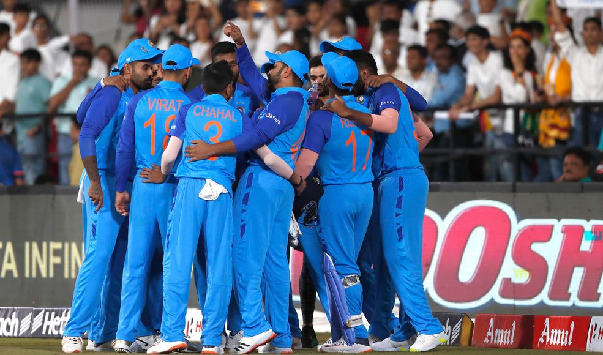
India in T20
World cup 2022
What went wrong with the
team losing in semifinals?
Analysis by group 2

Slide 2
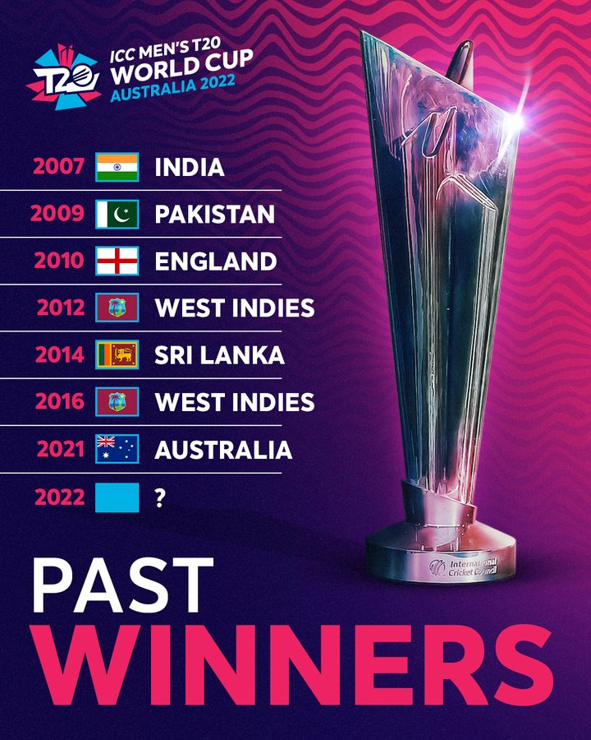
T20 World Cup History/Overview
India’s T20 World cup journey
2007: Champions (Yuvraj Singh hitting 6 sixes in an over and India vs Pakistan Final match was the highlight of the tournament)
2009: Knocked out in the league matches( This was India’s worst campaign in T20 World cup till now)
2010: Knocked out in Quarter final
2012: Knocked out in Quarter final
2014: Runners up (Virat Kohli was named the Player of the tournament)
2016: Semi Finalists (Virat Kohli was the Player of the tournament again and it also turned out to be MS Dhoni’s last appearance in T20 WC’s)
2021: Super 12
2022: Semifinalists (Virat Kohli was the highest run scorer of the tournament)
Notes:
Yuvraj Singh’s 6 sixes in an over : https://www.youtube.com/watch?v=8b0ubLO2MUE

Slide 3
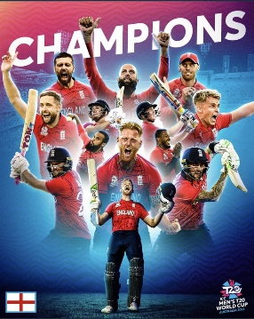
T20 World Cup 2022 in a glance
Total No. of teams participated:
England (Winners)
Pakistan (Runners up)
India (Semifinalist)
New Zealand (Semifinalist)
South Africa
Australia
Zimbabwe
Sri Lanka
Bangladesh
Ireland
Afghanistan
Netherlands
Top 5 Bowlers of the tournament:
Wanindu Hasaranga(Sri Lanka) – 15 wickets
Sam Curran(England) – 13 wickets
Bas de Leede(Netherlands) – 13 wickets
Blessing Muzarabani(Zimbabwe) – 12 wickets
Anrich Nortje(South Africa) -11 wickets
Top 5 Batsman of the tournament:
Virat Kohli(India) – 296 runs
Max O’Dowd(Netherlands) – 242 runs
Suryakumar Yadav(India) – 239 runs
Jos Buttler(England) – 225 runs
Kusal Mendis(Sri Lanka) – 223 runs
Venues:
Melbourne Cricket ground
Blundstone Arena
Adelaide Oval
Sydney Cricket ground
GMHBA stadium
The Gabba
The 2022 ICC Men's T20 World Cup was the eighth ICC Men's T20 World Cup tournament.
Sam Curran(England) won the man of the series.

Slide 4
INDIA IN ICC T20 WORLD CUP 2022
Match | Venue | Match Score | Top performers
India vs Pakistan | MCG, Melbourne | India 6/160 def. Pakistan 8/159 | Virat Kohli- 82*(53) Hardik Pandya- 3/30(4)
India vs Netherlands | SCG, Sydney | India 2/179 def. Netherlands 9/123 | Virat Kohli- 62*(44) Rohit Sharma-53(39) Surya yadav-51*(25) B Kumar-2/9(3)
India vs South Africa | Optus Stadium, Perth | South Africa 5/137 def. India 9/133 | Suryakumar Y-68(40) Arshdeep Singh-2/25(4)
India vs Bangladesh | Adelaide Oval, Adelaide | India 6/184 def. Bangladesh 6/145 (DLS) | Virat Kohli- 64*(44) KL Rahul- 50(32) Hardik Pandya- 2/28(3)
India vs Zimbabwe | MCG, Melbourne | India 5/186 def. Zimbabwe 115 | Suryakumar Y- 61*(25) KL Rahul- 51(35) Ashwin- 3/22(4)
India vs England | Adelaide Oval, Adelaide | Semi-Final: England 0/170 def. India 6/168 | Hardik Pandya- 63(33) Virat Kohli- 50(40)
Notes:
This is a short overview of every match that India played in this World cup. The content in the table are as follows: First column is the matches played the second is the venue in which the matches were played, the third is the summary of the match and the fourth column comprises of the top performer in each of the matches which clearly highlights only 2 to 3 players in every match. As we can see that few players delivered in almost all of the matches.

Slide 5
Batting Analysis:
Total runs scored by India in this world cup was 1010 out of which Virat Kohli scored 296 runs and Suryakumar scored 239 runs which if combined is more then half of the runs the whole team scored in the tournament, which clearly states that the team heavily relied upon these two batsman.
Bowling Analysis:
Total wickets taken by India in this world cup out of 6 matches was 44, in which Arshdeep Singh took the highest number of wickets i.e.10 wickets with a good economy rate, but it was observed that the rest of the bowlers were not so consistent and economic with the stats.
Even though the youngster was the pick of the tournament there was a lack of experience in the bowling line up of Indian team.
Notes:
Moving onto the next slide, we can see the two pie charts, First one is the contribution of runs by the Indian batters. So it was seen that the total runs scored…..

Slide 6
What went wrong?
Lack of experience in the bowling line up: The selection panel picked up few new faces into the team just before the big event, which resulted in lack of grooming of these youngsters in the foreign wickets.
Big names ruled out of tournament due to injuries: Jasprit Bumrah and Ravindra Jadeja were ruled out due to injury just before the tournament which weakened the team combination. The Board should focus more on these superior leagues rather than promoting their players in the domestic premier leagues.
The selection committee needs to be unbiased with the selection procedure. Lots of potential talents are not given chance whereas selectors backing up few players even after a long run of poor performances.
Table toppers in the league matches but not good enough in the knockout games. India has failed to deliver in the knockout games in these big tournaments. The players need to focus more on how to handle the pressure in these big games.
Last but now the least, “Cricket is a game of uncertainties”, and clearly England outplayed Indian team on this big occasion and eventually winning the T20 World Cup 2022.

Slide 7
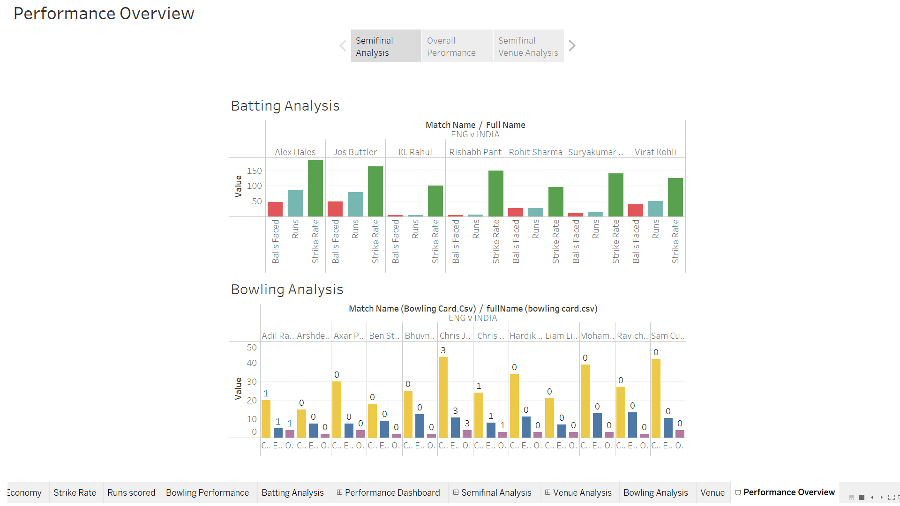

Slide 8
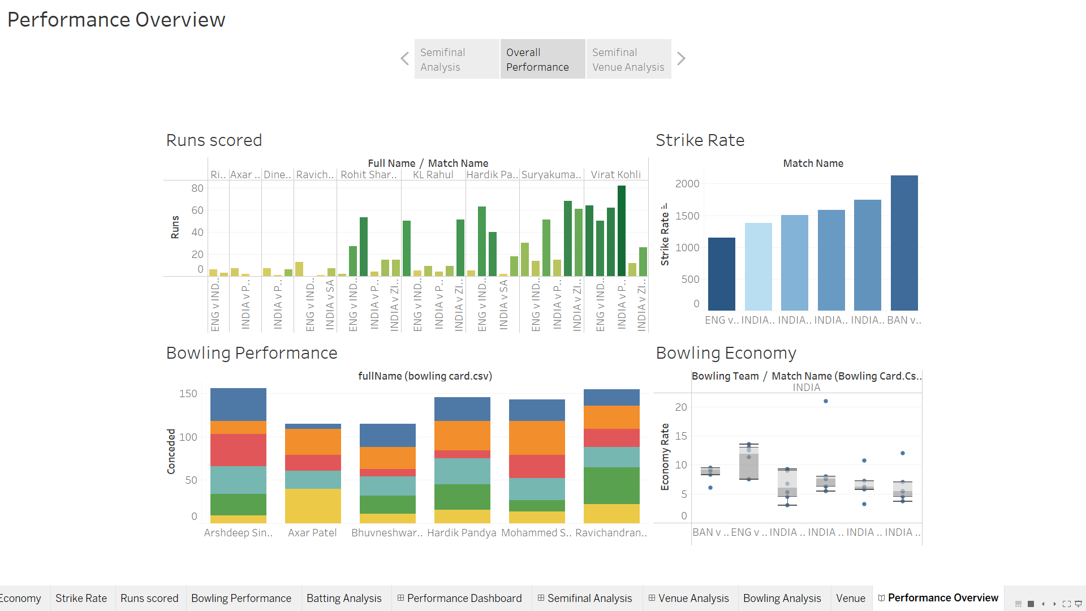

Slide 9
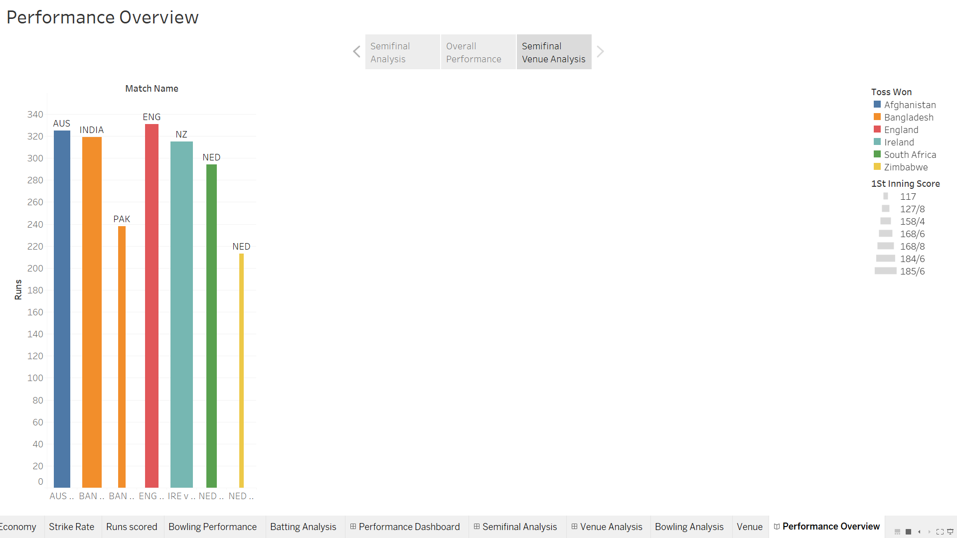

Slide 10
JAI HIND
THANK YOU!
References:
https://sportstar.thehindu.com/cricket/indian/chetan-sharma-bcci-selection-panel-kohli-captaincy-bumrah-t20-world-cup/article66156546.ece
https://sports.ndtv.com/t20-world-cup-2022/stats/4661-12-bowling-statsdetail
https://www.icc-cricket.com/news/2909193
sportingnews.com/au/cricket/news/t20-world-cup-2022-india-squad-schedule-results-and-likely-opponents/pz9jws0tazsecape7tlgzr8x
https://babacric.in/stats-records/india-records-and-stats-in-knockouts-semifinals-finals-in-t20-world-cup
https://www.cricketworld.com/cricket/series/icc-mens-t20-world-cup-2022/stats/bowling-top-wicket-takers/122941

